Slide 1




Automated Customs Clearance by
www cargo-overseas.co.uk

Slide 2



What is happening?
On the 31st December 2020 the UK’s transition period ends and the UK will leave the EU
Whilst physical inspection regimes and trade talks remain uncertain, any UK company that imports from, or exports to, the EU will be REQUIRED to complete a UK customs declaration for every shipment
It is estimated that this will result in an extra
820,000
customs declarations every DAY
There is limited supply of trained customs agents to meet this substantial additional demand, which could lead to delays at UK ports
If you export goods to, or import goods from, the EU you will need to make provision to ensure your shipments are processed through UK Customs

Slide 3

What can ACE by cargo overseas do to help?
Cargo Overseas has developed an IT solution for UK importers and exporters to efficiently process their customs declarations with HMRC; this solution is our Automated Customs Entry (ACE) dashboard
Ace’s interactive dashboard features include:
Instant submission of your customs declarations through our online portal
Simple and timely data capture
Live status of customs declarations updated from HMRC
Notifications of actions required for clearances
Storage of customs documentation for ease of compliance
Searchable custom’s commodity codes database

Slide 4

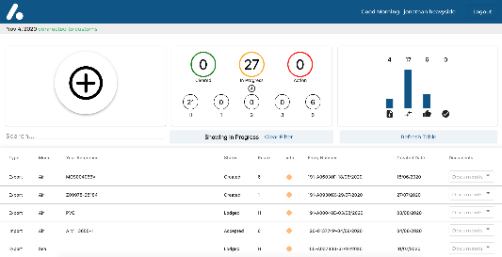
How does ACE work ?
Data Capture
Smart Form
API
Templates
OCR Existing Documents
ACE Dashboard
HMRC

Slide 5

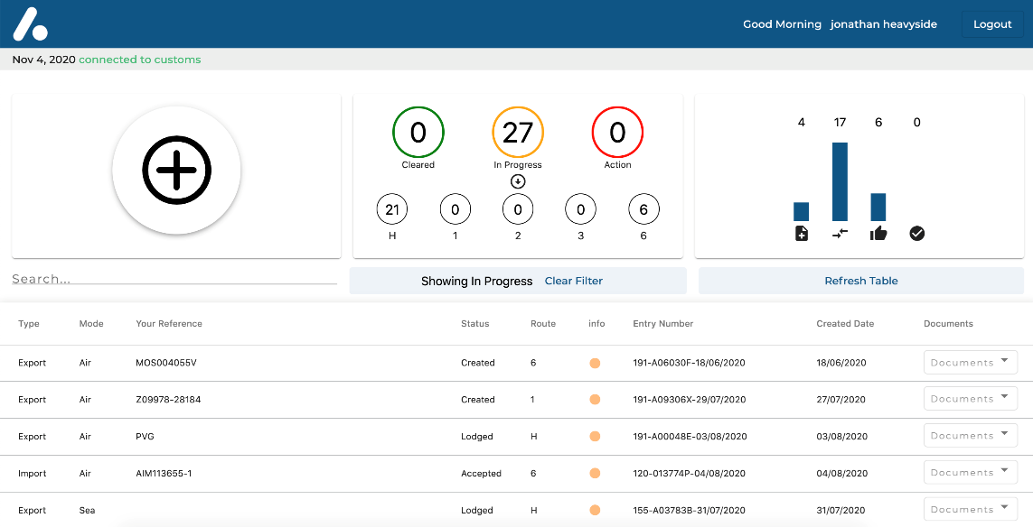
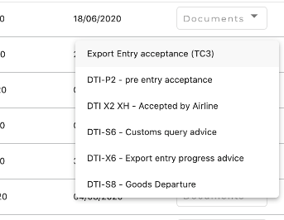
The Dashboard
Live status summary
Simple Data Capture
Required action notifications
BI Metrics
Fully searchable
Associated custom
documents
List your custom
declarations
Live status
Customs declaration numbers
Traffic light system

Slide 6
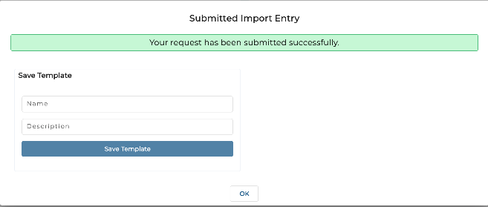
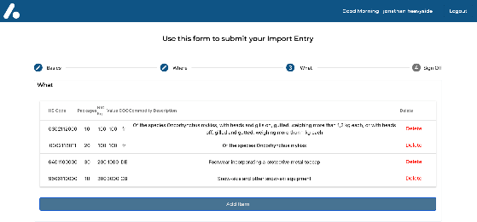
The data capture methods
Four time saving options:
Smart form data entry
Templates retain data for regular suppliers/customers
OCR data capture from your documentation
API directly from your ERP into the aCe dashboard
Instant / Simple
OCR reads your commercial invoice
Intuitive and simple smart form, including worldwide address look up
Customs commodity code lookup functionality

Slide 7
API direct from your ERP
Public API for receiving customs entries directly into the ace portal
Full documentation and example calls located at ace.forwarding.digital/developer docs.
Test API keys are available on request

Slide 8

WHY US?
Cargo Overseas has over 30 years’ experience performing the same customs declaration processes for hundreds of our clients who currently import and export to non-EU countries around the world
Where we differentiate is that we combine our extensive freight industry knowledge with the latest digital technologies to deliver an uncomplicated Brexit solution
We provide simple data capture, automated processing and real-time information to ensure minimal impact to your business
We are responsive to the ever moving landscape of leaving the EU and continually innovate to find better ways to address the challenges our clients face

Slide 9

HOW MUCH?
Our pricing structure is designed to be as simple and transparent as possible.
All users will have access to the dashboard platform and its standard features.
API / Template access
Basic access
OCR access
No fee
Annual contract and license fee (dependent on minimum commitment to volume of entries)
Initial set up fees (dependent on complexity/volume of document templates)
Smart form data entry
Smart form, API and Template data entry options
Smart form and OCR data entry
£45 per customs declaration entry
£40 per customs declaration entry
£40 per customs declaration entry

Slide 10
Contact us and we can provide zoom/teams meetings to demonstrate the product and pricing specific to your requirements and volumes. Remember the ACE system can be used for non-EU customs declarations as well, so please ask us regarding your worldwide requirements.
aceinfo@forwarding.digital
www.cargo-overseas.co.uk
O
C NTACT US

